Slide 1
Customer Churn Analysis
Data-Driven Business Insights & Recommendations
Presented by: Shahul shibin TP
Project Type: Capstone – Real World Business Analysis
Tools Used: Python, Pandas, Matplotlib, Seaborn

Slide 2
BUSINESS PROBLEM
Problem Statement
Customer churn reduces company revenue and growth
Acquiring new customers is more expensive than retaining existing ones
Identifying churn drivers helps businesses take preventive action
Goal:
Understand why customers churn and how to reduce it

Slide 3
Objectives
Analyze customer churn patterns
Identify key factors influencing churn
Use statistical analysis to validate findings
Provide actionable business recommendations

Slide 4
DATASET OVERVIEW
Dataset Information:
Dataset: Customer Churn Data
Total Rows: 500+ customers
Key Columns:
  Tenure
  Monthly Charges
  Total Charges
  Contract Type
  Payment Method
  Churn Status

Slide 5
DATA ANALYSIS WORKFLOW
End-to-End Process
Data Collection
Data Cleaning & Preparation
Exploratory Data Analysis (EDA)
Statistical Analysis
Insights & Recommendations

Slide 6
DATA CLEANING SUMMARY
Cleaning Steps Performed
Removed duplicate records
Handled missing values
Verified data types
Created clean dataset for analysis
Result:
✔ Reliable, analysis-ready data

Slide 7
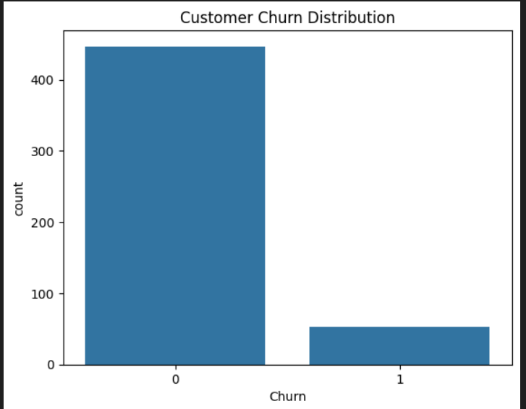
CHURN DISTRIBUTION
Churn Overview
Key Observation:
Significant portion of customers are churning
Indicates need for immediate retention strategies

Slide 8
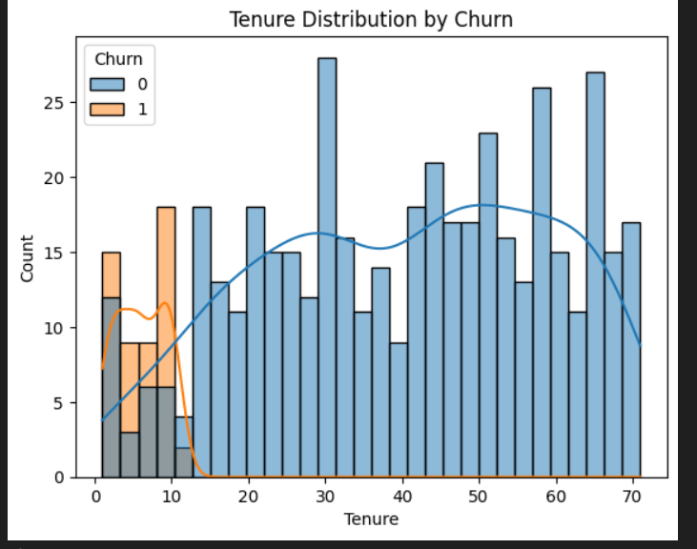
TENURE VS CHURN
📉 Customer Tenure Analysis
Insight:
Customers with low tenure churn more
Early customer experience is critical

Slide 9
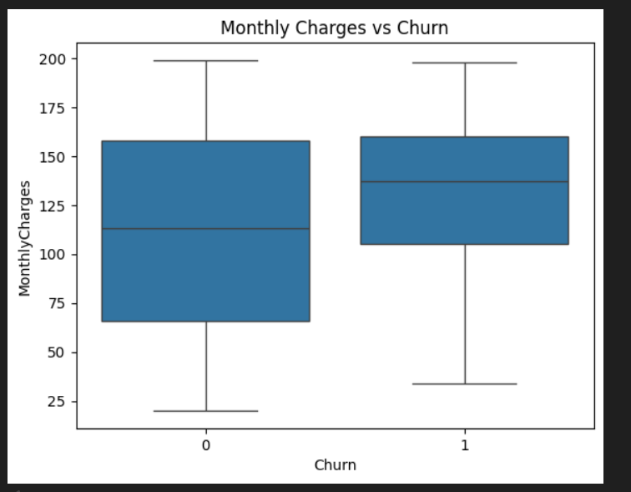
MONTHLY CHARGES VS CHURN
Pricing Impact:
Insight:
Higher monthly charges increase churn probability
Customers are price-sensitive

Slide 10
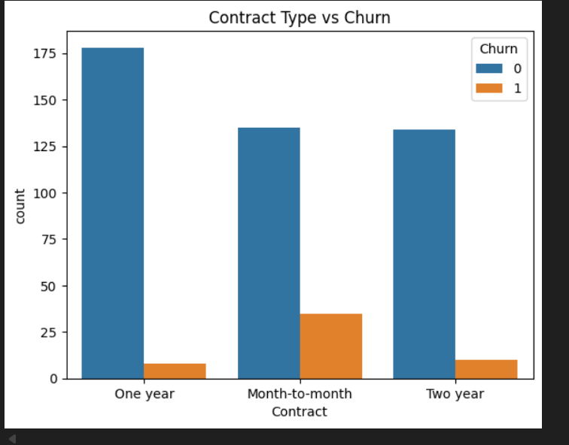
CONTRACT TYPE VS CHURN
Contract Analysis
Observation:
Month-to-month contracts have the highest churn
Long-term contracts improve retention

Slide 11
STATISTICAL ANALYSIS
Hypothesis Testing
Question:
Do churned customers pay higher monthly charges?
Method:
Independent T-Test
Result:
p-value < 0.05
Statistically significant difference found

Slide 12
KEY INSIGHTS SUMMARY
Major Findings
High monthly charges increase churn
Low-tenure customers are most vulnerable
Contract duration strongly affects retention
Pricing strategy plays a major role

Slide 13
BUSINESS RECOMMENDATIONS
Actionable Strategies
Offer discounts for long-term contracts
Improve onboarding for new customers
Provide loyalty benefits after 6 months
Target high-risk customers with retention offers

Slide 14
IMPLEMENTATION PLAN
How to Apply These Insights
Identify high-risk customers monthly
Offer personalized retention plans
Monitor churn KPIs regularly
Adjust pricing and contract strategies

Slide 15
CONCLUSION
Final Conclusion
Data-driven analysis reveals key churn drivers
Early engagement and pricing optimization are critical
Implementing recommendations can reduce churn significantly
Thank You 🙏

